Slide 1
Responsivo
Site para todos os tamanhos

Slide 2

Mobile First
More often than not, the mobile experience for a Web application or site is designed and built after the PC version is complete. Here's three reasons why Web applications should be designed for mobile first instead. - Luke Wroblewski

Slide 3
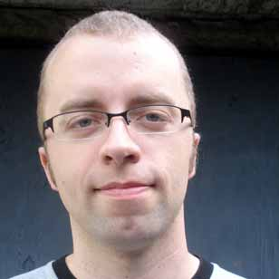
Web Design Responsivo
The control which designers know in the print medium, and often desire in the web medium, is simply a function of the limitation of the printed page. We should embrace the fact that the web doesn’t have the same constraints, and design for this flexibility. But first, we must 'accept the ebb and flow of things- Ethan Marcotte - http://alistapart.com/article/responsive-web-design.

Slide 4


Slide 5
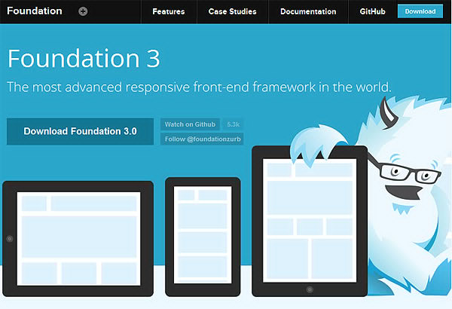

Slide 6
Instalar
http://foundation.zurb.com/sites/download.html/

Slide 7
Estrutura inicial
.
├── css
│ ├── foundation.min.css
│ └── normalize.css
├── img
├── index.html
└── js
├── foundation.min.js
└── vendor
├── fastclick.js
├── jquery.js
└── modernizr.js

Slide 8
IEstrura inicial html
<!DOCTYPE html>
<html lang="pt-br">
<head>
<meta charset="UTF-8">
<title></title>
<link rel="stylesheet" href="css/normalize.css" type="text/css" media="screen" charset="utf-8">
<link rel="stylesheet" href="css/foundation.min.css" type="text/css" media="screen" charset="utf-8">
<script src="js/vendor/modernizr.js"></script>
</head>
<body>
<script src="js/vendor/jquery.js"></script>
<script src="js/vendor/fastclick.js"></script>
<script src="js/foundation.min.js"></script>
</body>
</html>

Slide 9
<nav class="top-bar" data-topbar role="navigation">
<ul class="title-area">
<li class="name">
<h2><a href="#">Nome Site </a></h2>
</li>
<li class="toggle-topbar menu-icon"><a href="#"><span>Menu</span></a></li>
</ul>
<section class="top-bar-section">
<ul class="right">
<li class="active"><a href="#">Menu ativo</a></li>
<li>mais 1</li>
<li class="has-dropdown">
<a href="#">Mais</a>
<ul class="dropdown">
<li><a href="#">dropdown</a></li>
<li class="active"><a href="#">2</a></li>
</ul>
</li>
</ul>
</section>
</nav>

